Slide 1
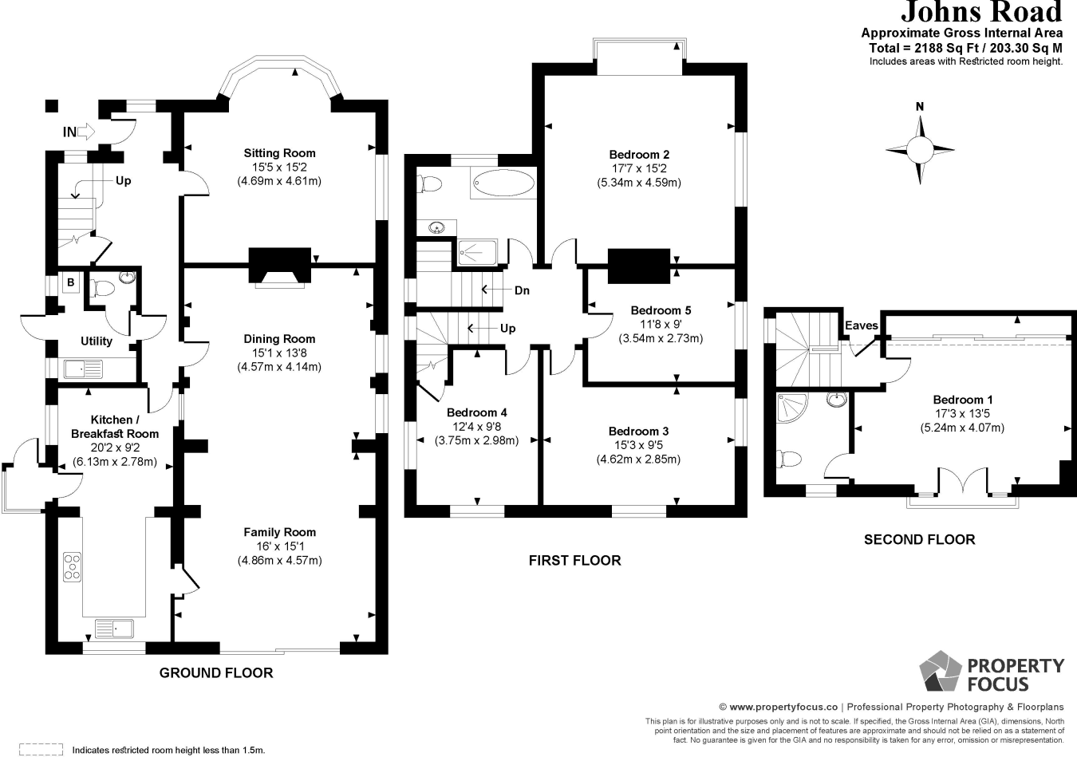
Manifold
Cabinets
4.59m
2.57m
SOFA
0.61m
Larder
FF
Larder
1.165m
SOFA
1.965m
1.849m
7.72m
6.13m
8.635m
(to cabinets)
0.631m
0.3m
Oven
Hob
2.45m
Lantern /
Sky Pod
0.62m
Oven
3m
3m
1.4m
1.2m
Cabinets
1.2m
DW
Drawers
0.631m
Ceiling Height: 2.6m
wine
3.74m

Slide 2
Electrical Plan
2 Gang USB
Virgin Box. Prior to the work commencing I moved the virgin cable to the study to ensure we had wifi through the build. Ideally I would like this moved back at the right time to feed the media wall systems. It is currently in the front sitting room (green diamond) and I would like it moved to the fireplace wall (other green diamond). The cable is long enough and the hole through the wall already exists.
2 Gang
Single Gang
Fireplace Wall Plan
32A for Induction Hob
0.4m
TV
0.4m
Up/Down Light
Manifold
Cabinets
0.4m
0.4m
0.4m
SOUNDBAR
0.4m
Virgin Box Location
Manifold
FIREPLACE
0.8m
0.8m
This is for the pop up 4 gang island plug socket (kitchen fitter to install so just a cable ready to go)
Larder
FF
Larder
Notes :
Any sky, TV coax or bt phone lines can be removed. We only use virgin for Internet and TV. We don’t have a land-line or need one.
Feel free to remove all other cables for a neat finish. Old microbore pipes can be removed.
Fan extractor to be hidden above oven units
Heat alarm to be linked to smoke detectors on each floor – location subject to building regs. .
The Manifold and pump will require power. The POC for this is Gary at ThermoScreed. (info@thermoscreed.co.uk). Programmed in to fit UFH on w/c 8 Oct unless there is scope to bring this left?
2.45m
This USB 2 gang plug socket is already fitted and content for it to remain.
Oven
Hob
Oven
Lantern /
Sky Pod
Cabinets
DW
Drawers
wine
This is illustrative of power for DW and Wine Cooler

Slide 3
Lighting Plan
= Different Colours for each circuit
1 | 2 | 3 | 4
As you face the switch
4 gang
Kitchen area (green) (double throw)
Dining Area (burnt orange) (double throw)
Living Room Area (purple) (double throw)
Cabinet Up/Down Lights (Blue) (single throw)
Spotlight
Up/Down Light
Single pendant linked to hallway light as discussed.
Cabinets
Switch
Larder
FF
Larder
1 | 2 | 3 | 4
Oven
Hob
2.45m
Single Throw single pole switch for up/down lights
As you face the switch
Single Throw single pole switch for outdoor lights
Oven
Lantern /
Sky Pod
4 gang
Outside Lights (red) (single throw)
Living Room Area (purple) (double throw)
Dining Area (burnt orange) (double throw)
Kitchen area (green) (double throw)
Cabinets
DW
Drawers
wine

