Slide 1
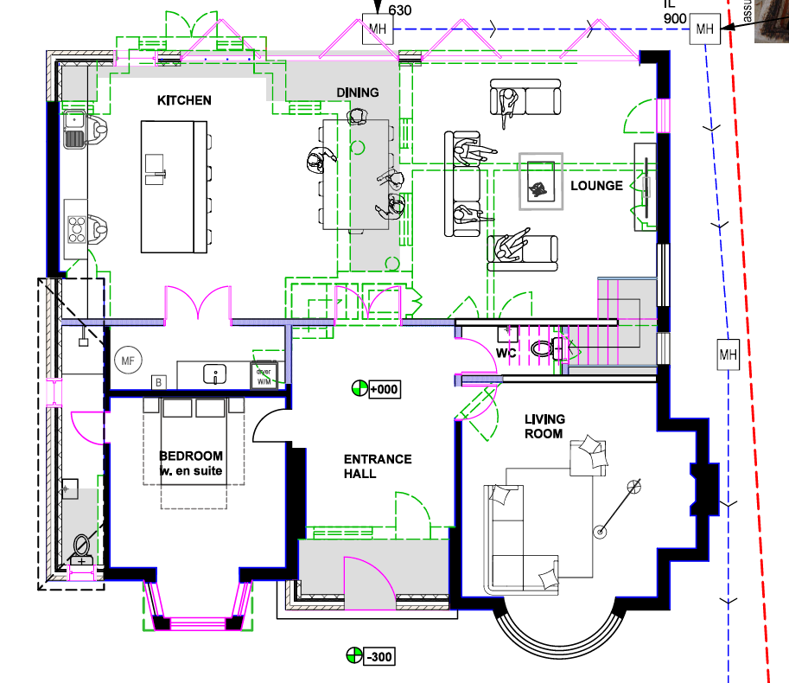
14852
Details
Manifold (12 port?) placed in the utility (MARKED)
Kitchen/Utility = Zone 1
Dining = Zone 2
Lounge = Zone 3
Bedroom/Bath = Zone 4
Entrance Hall = Zone 5
Living Room = Zone 6
Please propose how to cover Kitchen/Dining/Lounge area (approx.. 90 sq. mtrs)
100 m UFH = 20sq Mtrs
Total Area is approx. 180 sq. mtrs
- Should we split ensuite bath from bedroom?
5686
UTILITY
3733
1142
Manifold
2604
5683
3025
4025
5361
5383
5050
1150
4472

